Slide 1
UYP
Bo Fu, Yunzhe Liu, Calvin Tse

Slide 2
UYP
University for Young People (UYP)
The school of Education at Baylor University runs a summer program called “University for Young People” (UYP). This program provide summer classes for students (between 4th and 12th grade) identified as gifted and talented students.

Slide 3

Programming Language--Python
Easy to learn
Clarity and readability
Versatile
Fast to write
No glaring holes in its design

Slide 4

Django
Python-based free and open-source web framework
Follows the model-view-template architectural pattern

Slide 5
Who else use it ?
https://www.netguru.co/blog/top-10-django-apps-and-why-companies-are-betting-on-this-framework

Slide 6
Why Django?
Secure
Avoid SQL injection, cross-site request forgery, clickjacking and cross-site scripting
Fast
Focus more on design and logic
Administration GUI
Object-Relational-Mapping (ORM)
Scalability

Slide 7
Front End Framework-Bootstrap
Speed of Development
offering less CSS functionality and pre-built blocks of code
Customizable
Consistency
The results work uniformly across various browsers and the output remains same.

Slide 8
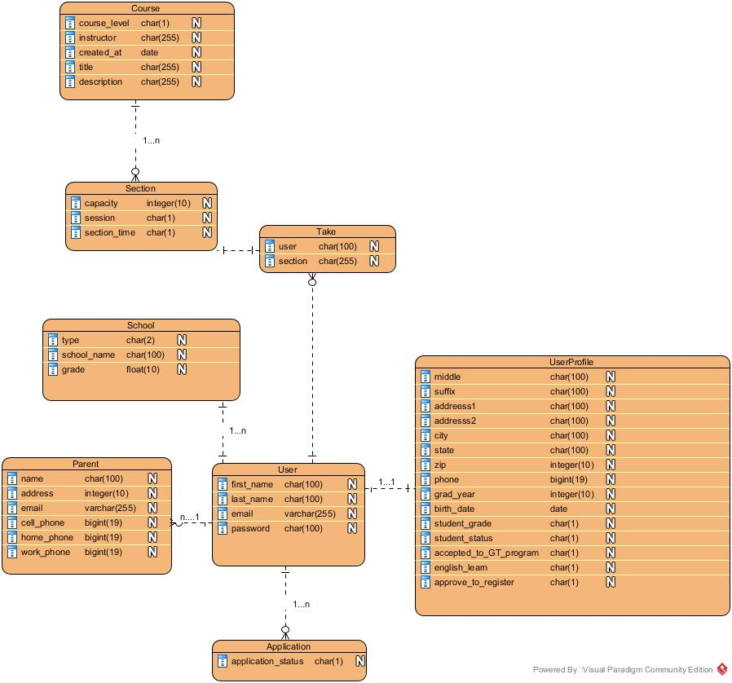
ERD

Slide 9
Presenting…

